Slide 1
CZ1115 Mini-project
Chen Weiyi, Chai Wen Xuan, Cheng Chang Wei
Lab Groups: FSP7
Team 2

Slide 2
TABLE OF CONTENTS
01
02
03
Problem definition
Data Preparation
Data Analysis
Data set chosen, programming problem
Cleaning of data
Exploratory analysis, feature selection

Slide 3
TABLE OF CONTENTS
04
05
06
Approach
Results
Conclusion
One-hot encoding, linear regression
Reliability of model
Solution, work distribution, citations

Slide 4
Problem Definition
01

Slide 5



Problem
We are a group of entrepreneurs planning to start a company to sell some products! However,since Chang Wei is good at making backpacks, Wei Yi is good at cooking, and Wen Xuan is good at making health beauty products, we are unsure which industry to enter!!
Bags?
Food?
Cosmetics?

Slide 6

Problem
From the point of view of an aspiring business owner:
Need to find out current competition in different industries
Pick the most suitable industry to enter and sell products in
Succeed by undercutting competitors
*Undercut = sell at lower price

Slide 7
Programming problem
Predict the prices of products using different (categorical) variables via machine learning.

Slide 8
Data set 5:
Olist E-Commerce and Marketing Datasets

Slide 9
Data Preparation
02

Slide 10

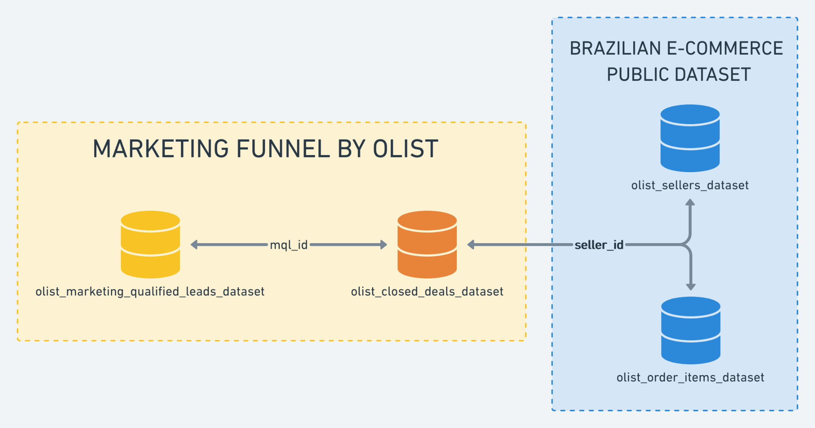
Relationship between Datasets

Slide 11
Data Cleaning Steps
1
2
3
4
Merge datasets according to common IDs (e.g. order_ID)
Remove unnecessary columns
Find IQR and remove outliers and rows with missing data
Remove IDs after merging

Slide 12
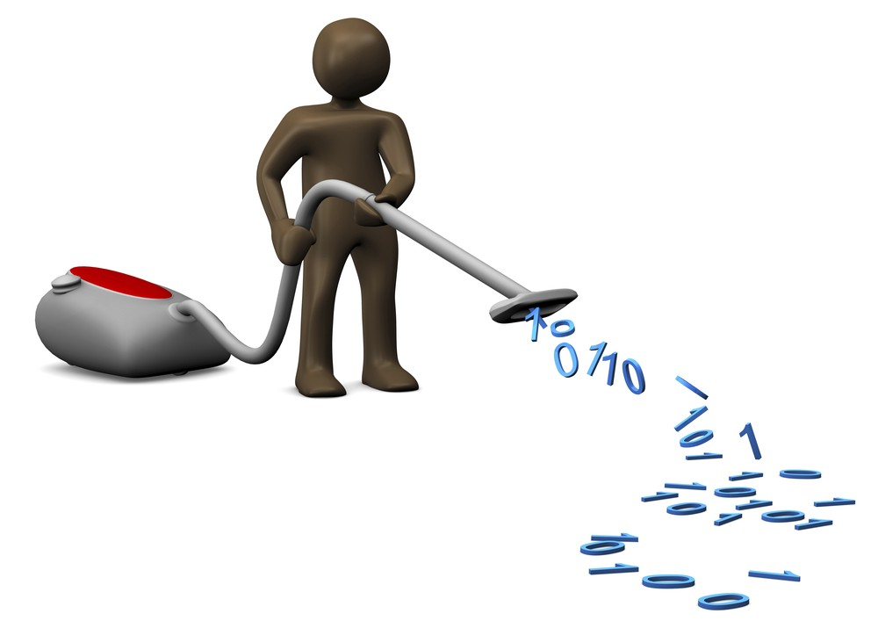


Cleaning data
Removal of unnecessary columns that have no bearing on price
E.g Product_ID,Order_ID ( used just for concatenation of data)
Removal of outlier data (Not selling luxury goods! Data irrelevant!)
Removal of rows with missing data

Slide 13
Data Analysis
03

Slide 14
Feature selection
Data type
Categorical
Numeric
Analysis of variance (ANOVA)
Pearson’s correlation

Slide 15
ANOVA Analysis on Categorical Data
Variable | F value | P value
business_segment | 31.965384 | 4.124299×10⁻¹⁵⁰
no_of_installments | 31.439898 | 1.772516×10⁻⁸⁶
lead_type | 15.294301 | 1.939101×10⁻¹⁷
product_type | 13.304735 | 2.057188×10⁻¹⁹⁰
review_score | 4.264375 | 0.001907

Slide 16
Pearson’s correlation
Pearson’s Correlation of Numeric Data
Variable | Correlation
product_weight_g | 0.26
product_length_cm | 0.13
product_height_cm | 0.15
product_width_cm | 0.08
freight_value | 0.23

Slide 17
Conclusion of Variables
Numeric data: not suitable
Categorical data: suitable
Variables used:
business_segment
no_of_installments

Slide 18
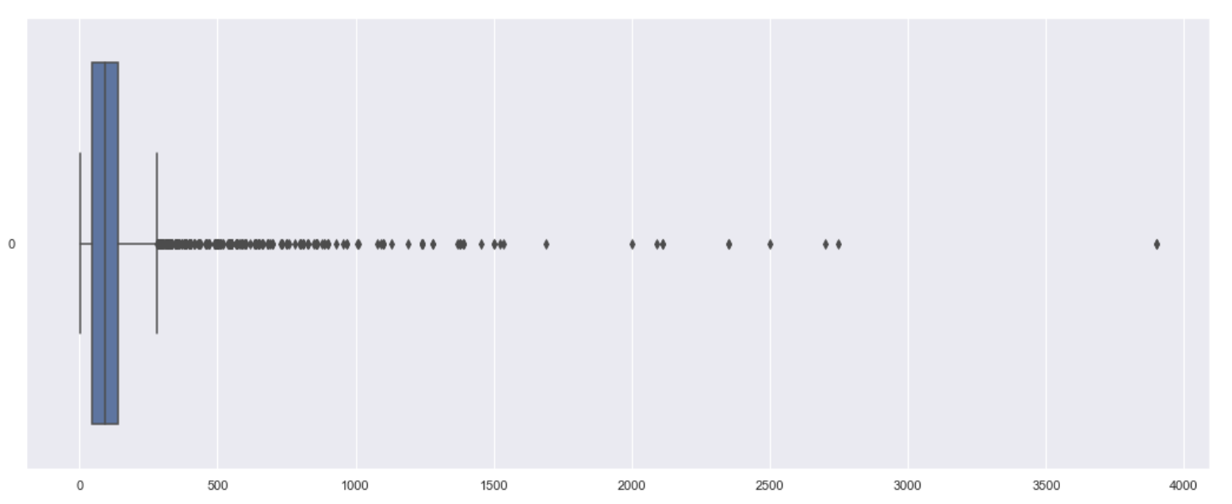
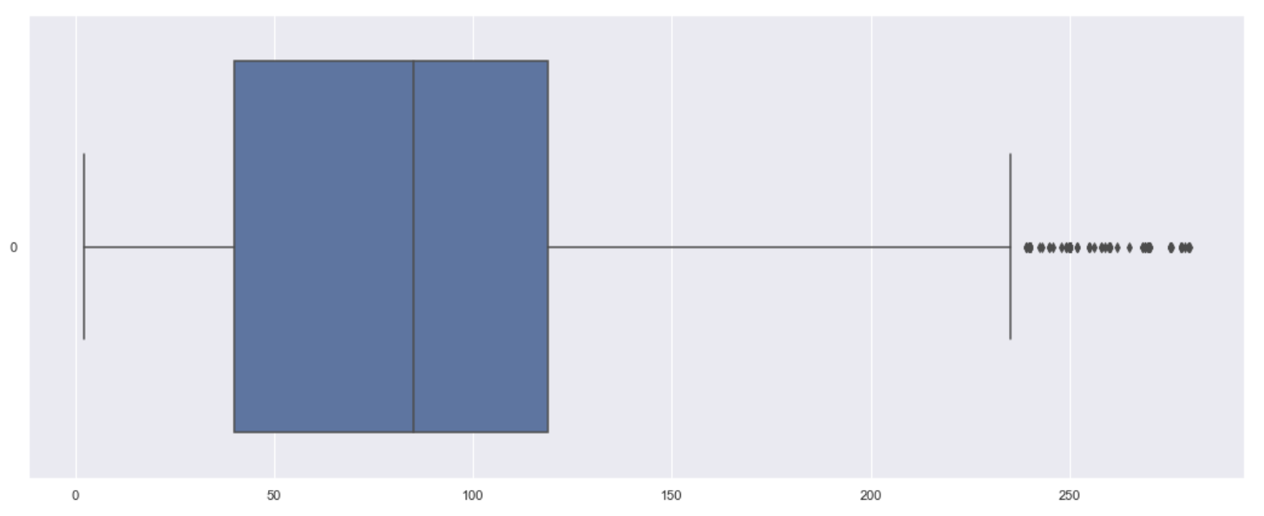
Price Before and After Data Cleaning
Before
After

Slide 19
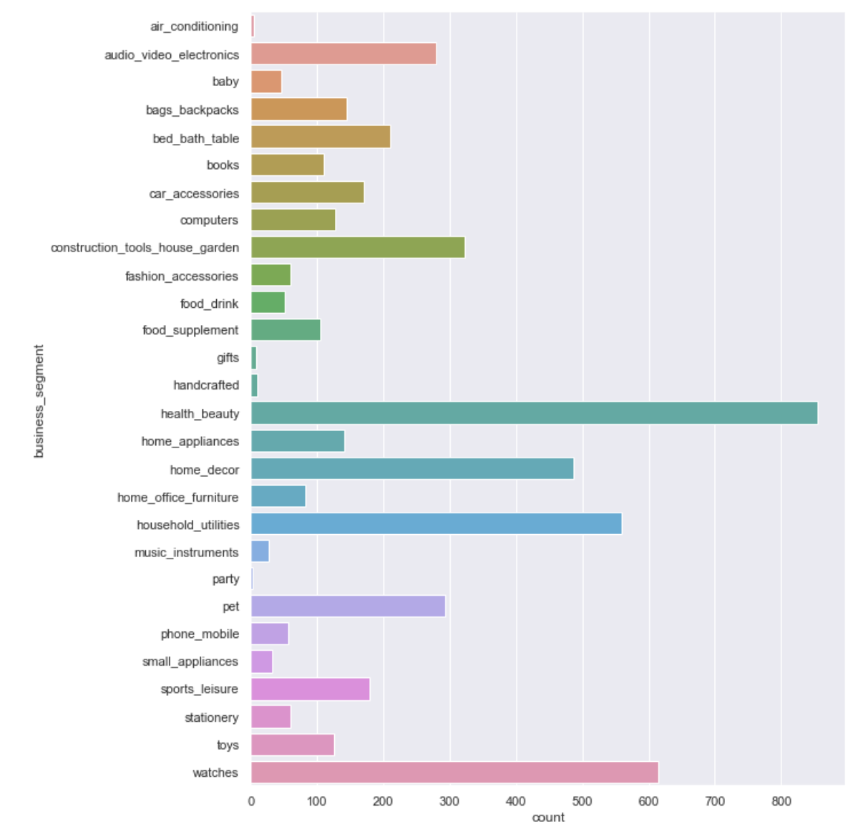
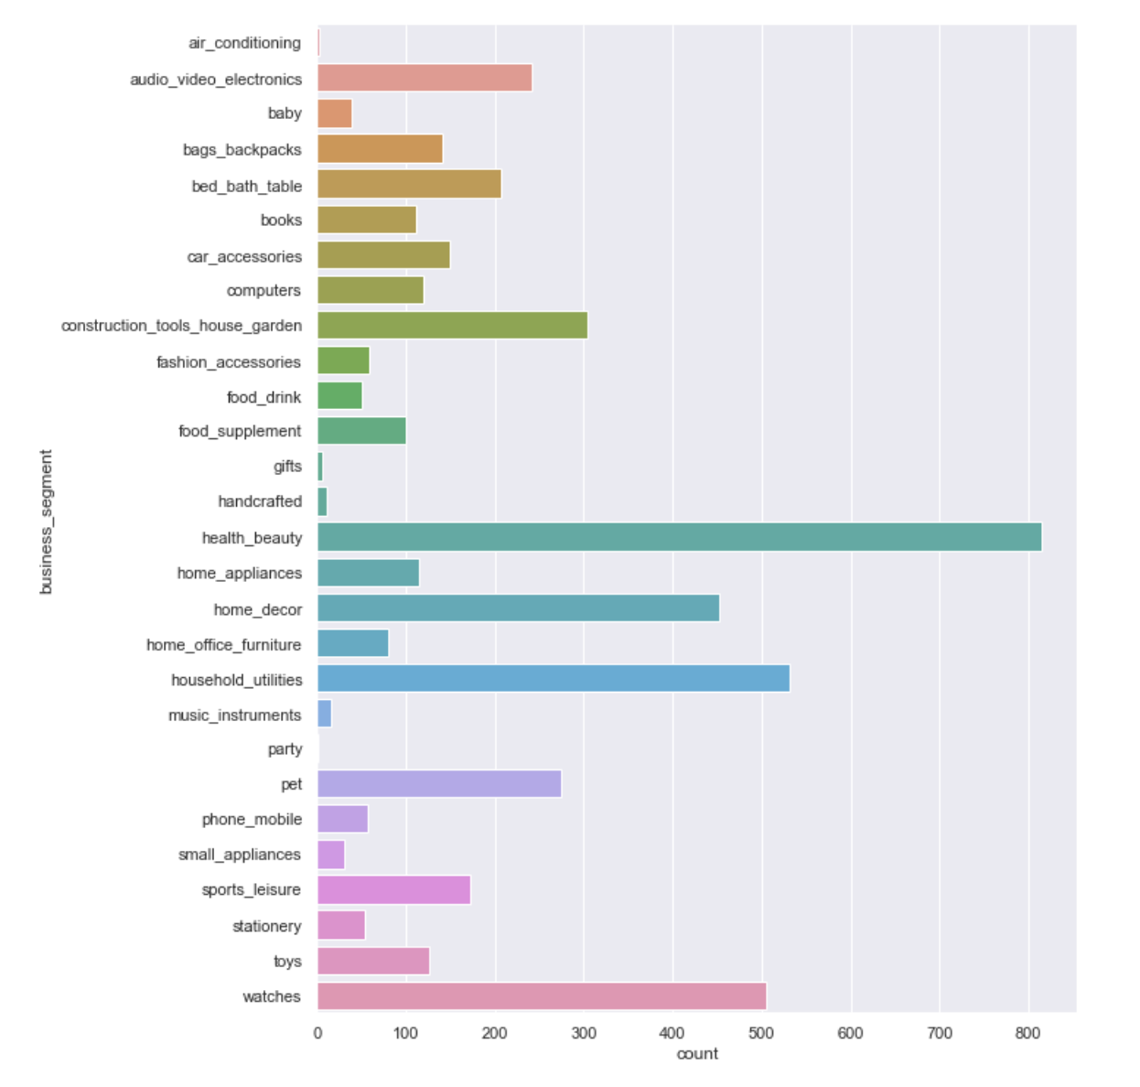
Business _segment data before and after cleaning
Before
After

Slide 20
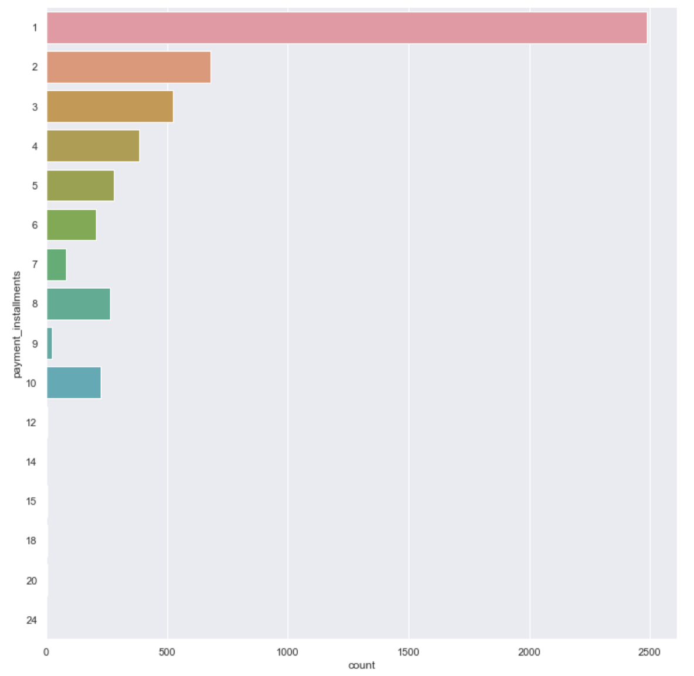
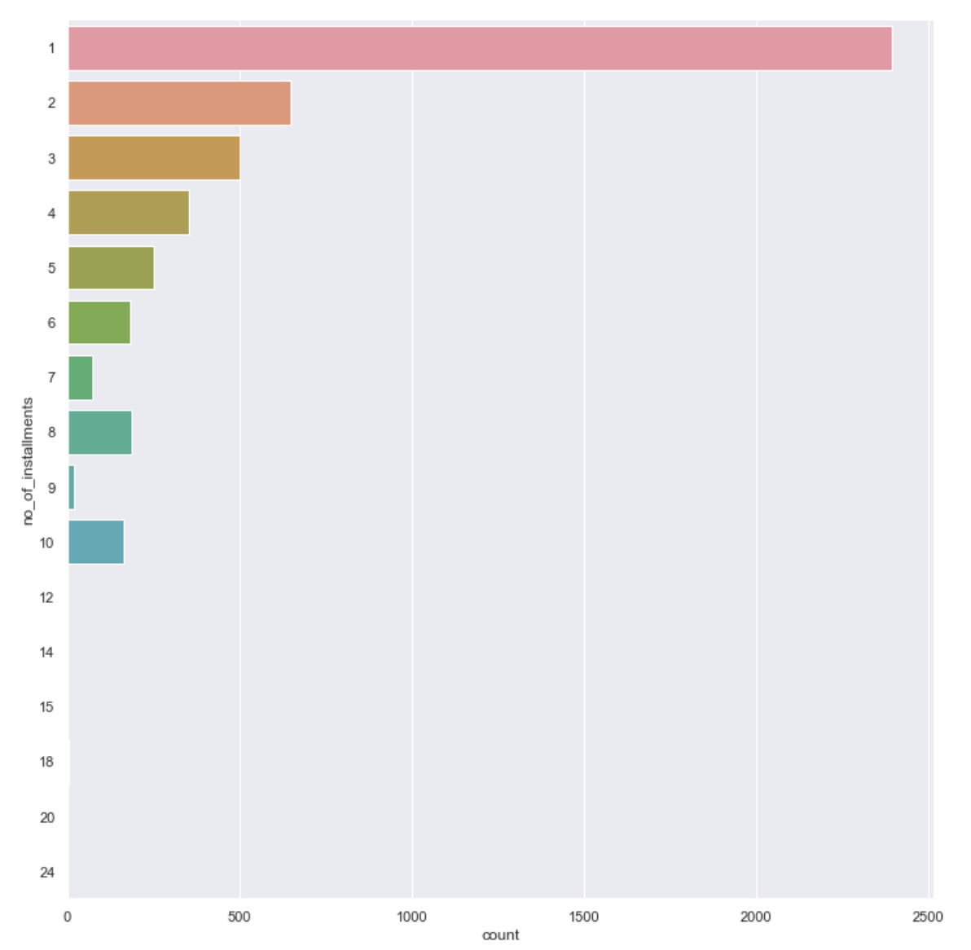
No_of_installments data before and after cleaning
Before
After

Slide 21
Approach
04

Slide 22
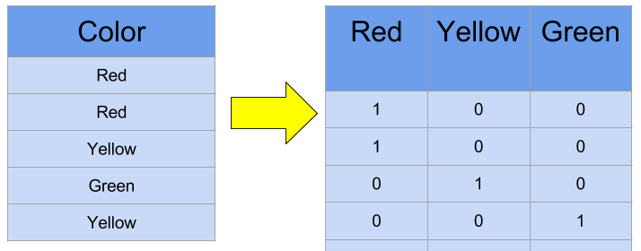
Machine Learning Approach
Main approach: linear regression
Problem: linear regression uses numeric predictors but our predictors are categorical
Solution: One-hot encoding

Slide 23
One-hot Encoding
No ordinal relationships between categories
Integer encoding causes the model to assume natural ordering between categories
Results in poor performance or unexpected results
One-hot encoding uses binary variable instead
Prevents natural ordering

Slide 24
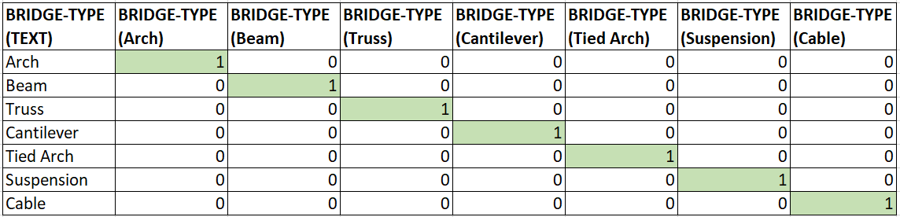
Example

Slide 25
Results
05

Slide 26
Overview of Price
 | Predicted Price | Actual Price
count | 957 | 957
mean | 88.85 | 87.72
std | 26.79 | 57.35
min | 38.15 | 2.20
25% | 71.35 | 40.99
50% | 83.12 | 79.90
75% | 99.64 | 118.00
max | 174.09 | 280.1

Slide 27
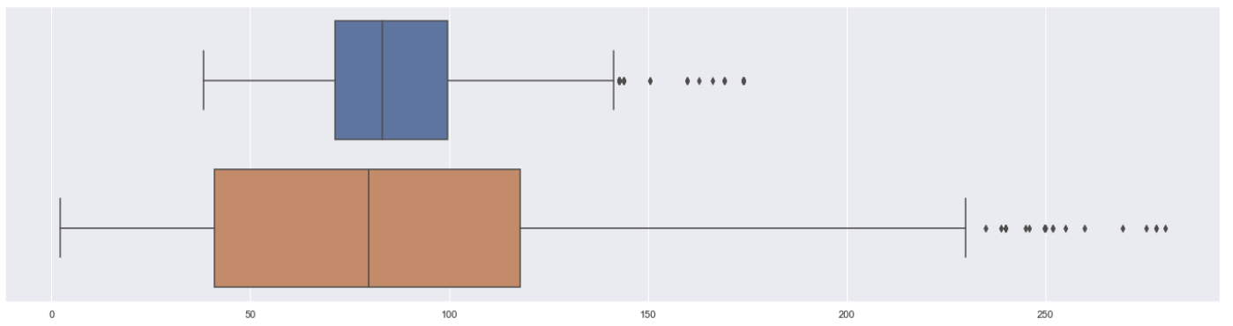
Box Plot of Predicted and Actual Price
Predicted
Price
Actual
Price

Slide 28
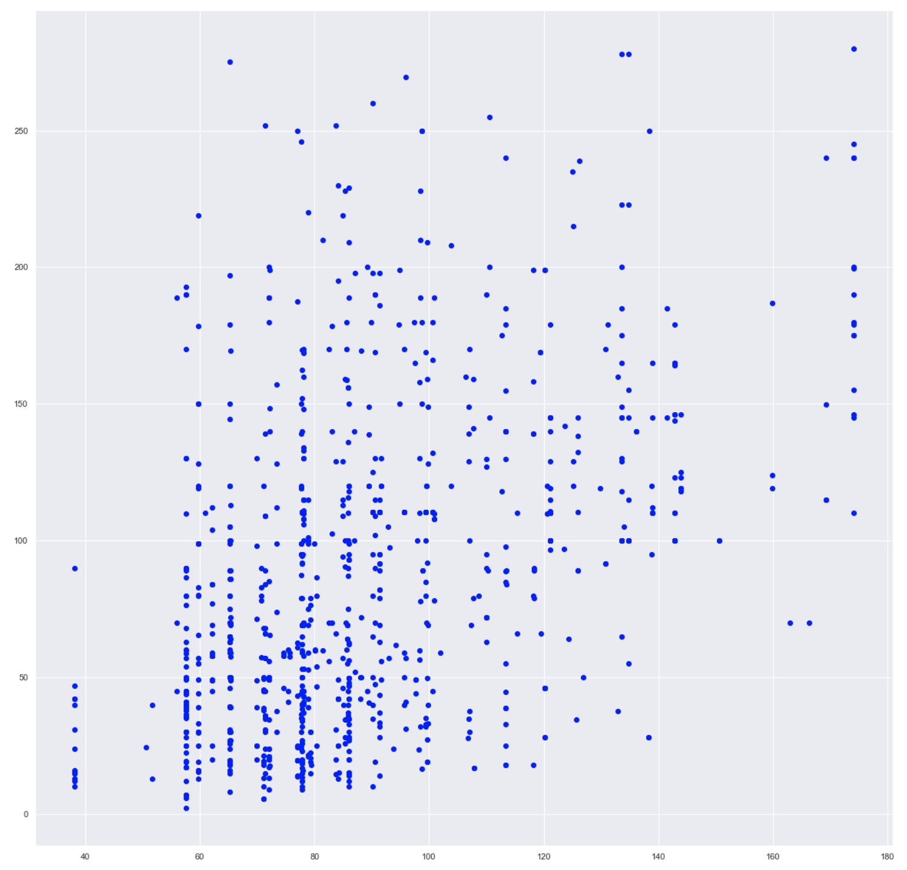
Scatter Plot of Actual Price against Predicted Price
MSE: 2660.69
R²: 0.191
Actual Price
Unfortunately, our R² isn’t very good despite our best efforts to clean and pick our data. Nevertheless, it can still be of some use.
Predicted Price

Slide 29
Conclusion
06

Slide 30
Decision time!!!
Need to decide on which industry to enter - decision based on our findings
Previously mentioned that we are good at making bags as well as health beauty products. Let’s see, based on our data, if any of these industries are financially viable for us to enter!
We have estimated our cost and profit margin of bags and HBP to be:
COP->$95
RTP->$100
COP->$45
RTP->$50

Slide 31
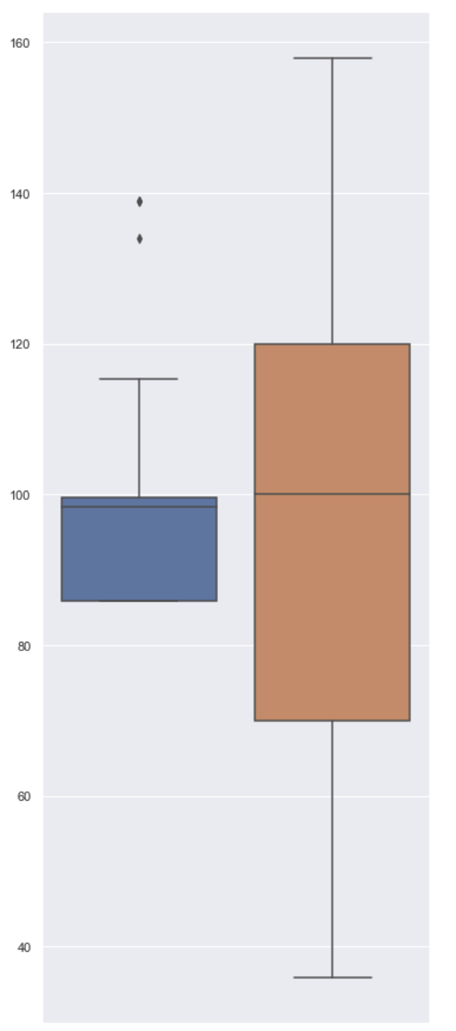
Prediction of business_segment Backpacks
 | Predicted Price | Actual Price
count | 29 | 29
mean | 98.21 | 96.65
std | 16.30 | 35.48
min | 85.91 | 35.90
25% | 85.91 | 69.90
50% | 98.34 | 99.99
75% | 99.52 | 119.90
max | 138.86 | 157.90
Predicted Price
Actual
Price

Slide 32
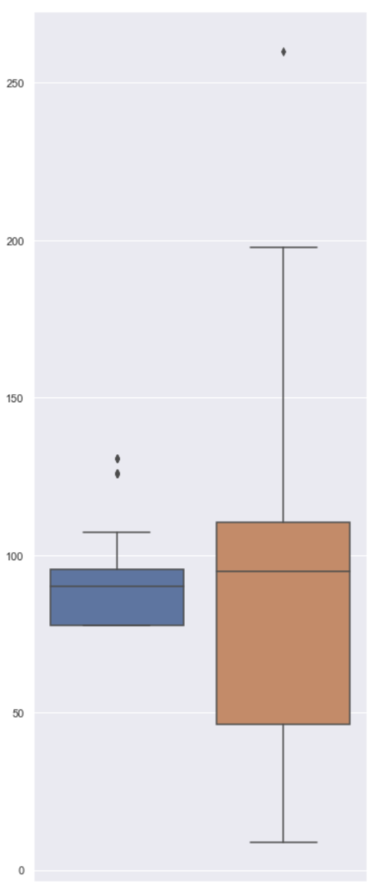
Prediction of business_segment Health Beauty
 | Predicted Price | Actual Price
count | 152 | 152
mean | 88.56 | 86.59
std | 13.10 | 45.44
min | 77.78 | 8.90
25% | 77.78 | 46.40
50% | 90.20 | 95.00
75% | 95.64 | 110.32
max | 130.72 | 259.99
Predicted Price
Actual
Price

Slide 33


Final decision: we are entering the health beauty industry to sell cosmetics!!!

Slide 34
Work Distribution
Chang Wei
Wen Xuan
Weiyi
ANOVA, one-hot encoding and script writing
Exploratory analysis, machine learning and data representation
Data cleaning, data visualisation and slide design

Slide 35
Citations
Brownlee, J. (2019, August 14). How to one hot encode sequence data in python. Retrieved April 14, 2021, from https://machinelearningmastery.com/how-to-one-hot-encode-sequence-data-in-python/
Brownlee, J. (2020, August 20). How to choose a feature selection method for machine learning. Retrieved April 14, 2021, from https://machinelearningmastery.com/feature-selection-with-real-and-categorical-data/
Gajawada, S. (2019, October 20). ANOVA for feature selection in machine learning. Retrieved April 14, 2021, from https://towardsdatascience.com/anova-for-feature-selection-in-machine-learning-d9305e228476
Kassambara, A. (2018, March 11). Regression with categorical variables: Dummy coding essentials in r. Retrieved April 14, 2021, from http://www.sthda.com/english/articles/40-regression-analysis/163-regression-with-categorical-variables-dummy-coding-essentials-in-r/#categorical-variables-with-more-than-two-levels
Korstanje, J. (2019, November 11). 1-Way ANOVA from scratch - dissecting the ANOVA table with a worked example. Retrieved April 14, 2021, from https://towardsdatascience.com/1-way-anova-from-scratch-dissecting-the-anova-table-with-a-worked-example-170f4f2e58ad
Liu, Y. (2018, September 20). Encoding categorical features. Retrieved April 14, 2021, from https://towardsdatascience.com/encoding-categorical-features-21a2651a065c
Moffitt, C. (2017, February 06). Guide to encoding categorical values in python. Retrieved April 14, 2021, from https://pbpython.com/categorical-encoding.html

Slide 36
THANK YOU

